Slide 1
Social Media

Slide 2
Social Media is a common and growing dataset used in digital humanities projects
Provides a plethora of information to analyze modern culture
Platforms are so widely used and ubiquitous they becomes targets of Humanistic critique
Allows the creation of “big data” - what boyd and Crawford suggest “is less about data that is big than it is about a capacity to search, aggregate, and cross-reference large data sets” - and the ethical issues and criticism that arise from treating people as data points (From Critical Question for Big Data, p, 663)

Slide 3
Collection & Methodology

Slide 4
Getting data from Social Platforms
Twitter
TAGS
TWARC (requires programming knowledge)
DocNow Archive (may require programming knowledge to get needed data)
Instagram
Instagram-scraper (requires programming knowledge)
Facebook
Ultimate-Facebook-Scraper (requires programming knowledge

Slide 5
Pre Research Decisions
How to scope information collection
By platform (Twitter or Facebook or both)
By date range (1 year is common)
By sample size (ie, 1 million tweets is common)
By type of data (tweets or webpages or both)
Decide type of research project
Topic (ie, social justice movement or fake news epidemic)
Issue (ie, Movement for Black lives, gentrification, or troll factories)
Event (ie, Ferguson or 2016 US presidential election interference)

Slide 6
Scope by Platform
Type of Research
Topic (fake news spread)
Issue (troll factories)
Events (2017 French election interference)
If you choose a topic based question it often needs to be confined to one platform to limit data
If you choose an issue or event research project, ask what groups are involved and what platforms are they using?
Are keywords, hashtags used?

Slide 7
Ethics

Slide 8
The Problems of Social Media and the Internet
Inauspicious starts of platforms, like Facebook
Google results seen as objective truth and fact
Transactional gatekeepers controlling interaction and communication between users
The development of filter bubbles and proliferation of “fake news” and “bots”

Slide 9
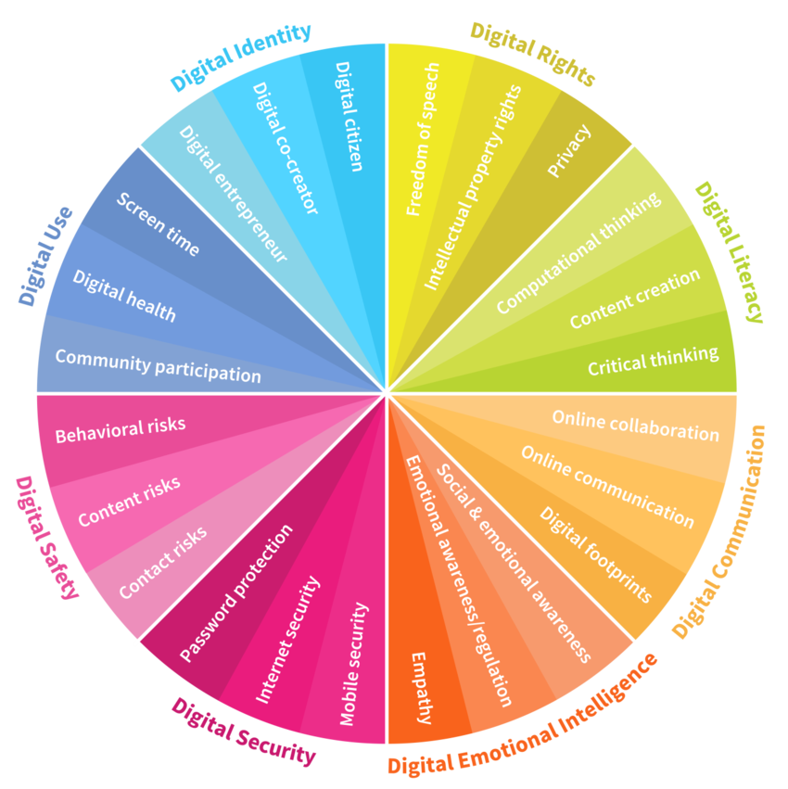
Do any of these categories factor into your use of social media?
graph from DQ Institutes Global Standards Report 2019
Notes:
Digital literacy and digital citizenship education has not kept up with the technology changes brought on by every-changing and new social media platforms.

Slide 10
Ethical approach to collection and archiving
1. Archivists should engage and work with the communities they wish to document.
2. Documentation efforts must go beyond what can be collected without permission from the web and social media.
3. Archivists should follow social media platforms’ terms of service where they are congruent with the values of the communities they are attempting to document.
4. When possible, archivists should apply traditional archival practices such as appraisal, collection development, and donor relations to social media and web materials.
From Documenting the Now White Paper (2018)

Slide 11
Ethical approach to research and analysis
1) People are more than digital data
‘Big data’ are only meaningful in interaction with in-depth ‘small data’ that value human subjectivities and meaning-making.
2) Context-specificity
The process of cleaning data to ensure software readability does not take place in a vacuum but reflects and shapes intersecting gender, race and classed power relations.
3) Dependencies and relationalities
Digital data-environments, like social media sites, are characterised by distinctive ‘platform values’ (Leurs and Zimmer, 2017), presupposing inevitable dependencies.

Slide 12
Ethical approach to research and analysis
4) Temptations
Researchers might fail to recognise that human subjects in research hold autonomy and authority over data, have the right to opt out, and can refuse to be coded.
5) Benefits and harm
Researchers are accountable for creating exploitative relationships with research participants. Rather than ‘do no harm’, research should be beneficial to the people involved.
From Koen Leurs’ Feminist data analysis (2017)

Slide 13
Grounded Theory

Slide 14
Glaser & Strauss (1967), sociologists: qualitative research method to link data analysis and theory development.
inductive: theories of meaning arise from the qualitative data itself rather than placing a theory on top of data--knowledge [categories] grows from grounding the concepts in observations of the data
categorize: categories are created by the researcher’s knowledge of the data’s background and situation as well as her observations of significant themes in the research
constant comparison: with each round of data categorization, new concepts may arise and you refine your categorization to better reflect your data as it grows
saturation: the goal is to reach a saturation level of concepts and categories and then you build your theory/message based on these concepts and categories

Slide 15
Develop a theory that explains something about the data
Theory
Put like and different data into categories until you have enough categories to contain any new data points
Category
Category
Identify similarities and differences between data and give them a label (concept)
Concept
Concept
Concept
Data
Data
Data
Data
Data

Slide 16
Grounded Theory & [Social Media] Data
Cresswell (2014): a “design of inquiry” whereby “a researcher derives a general, abstract theory of a process, action, or interaction grounded in the views of participants” (14).
How does grounded theory shape the project in “Arranging a Rhetorical Feminist Methodology” (Dighton, 2020)?
How does grounded theory assist in the visualizations in the project?
Theory: rhetorical concepts + grounded theory + visual display

Slide 17
Let’s Try It!
Go to Tweet Coding Activity
Pull up your Google Sheet A or B
Go to the URL for tweet 116
Follow steps 1-3
Discuss results
4. Go to the URL for tweet 117
Follow steps 1-3
Discuss results

